Slide 1


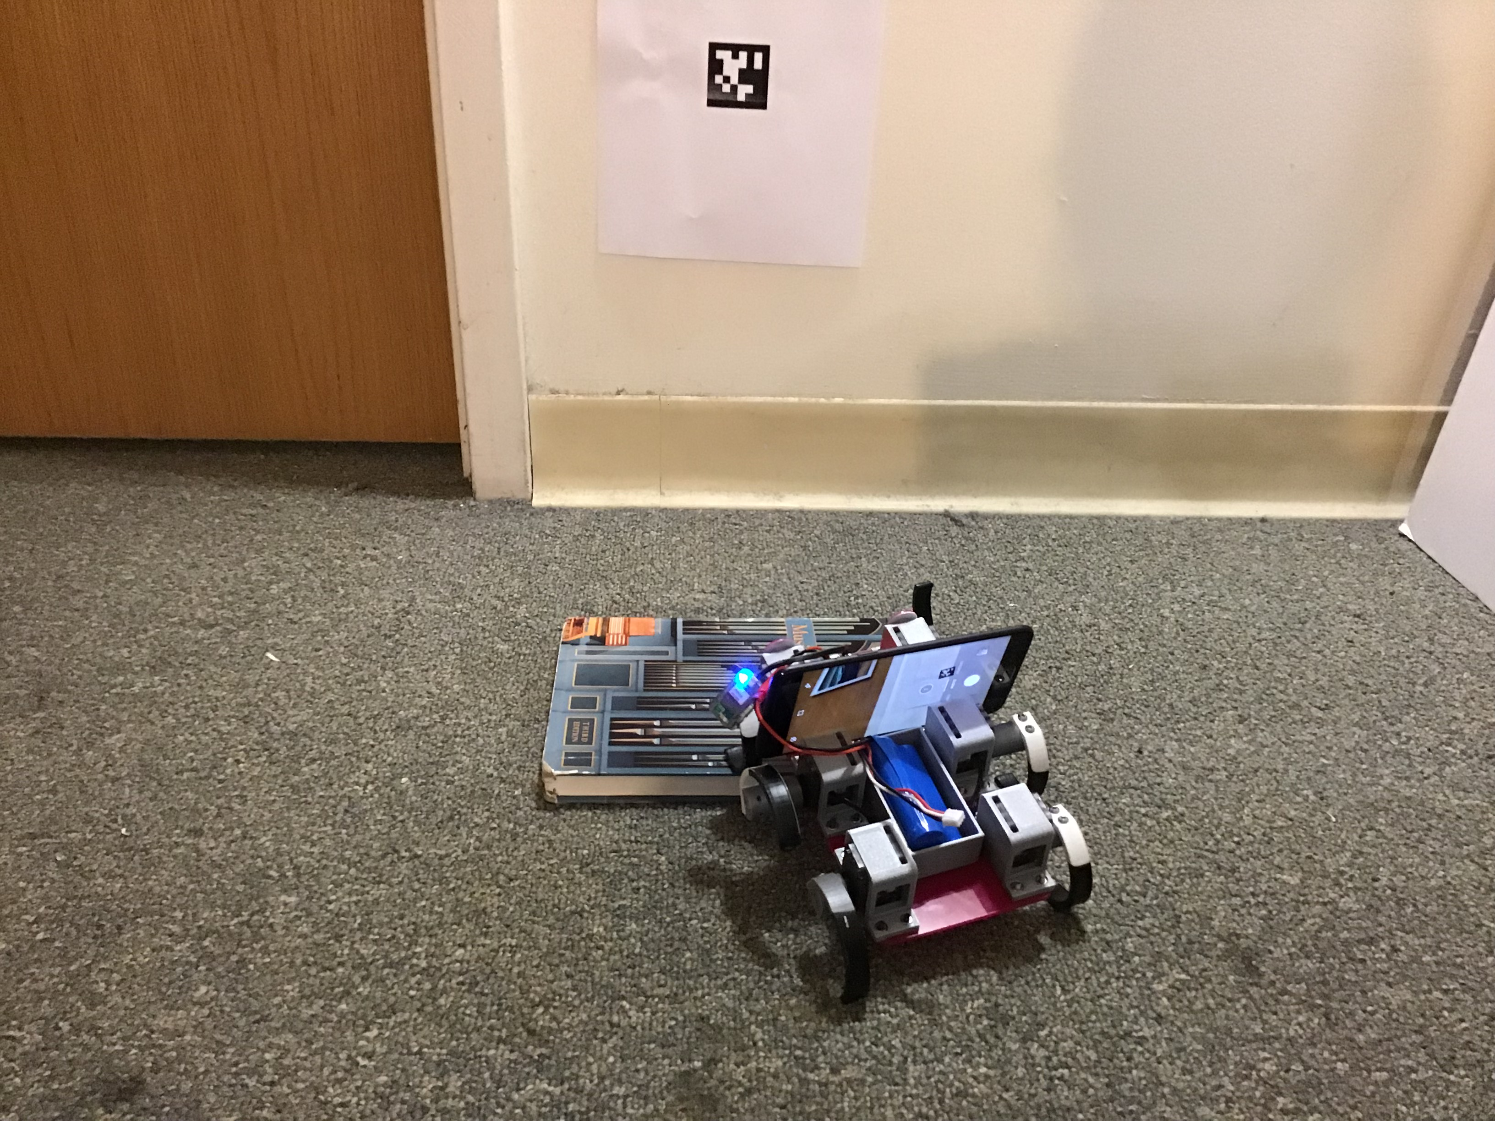
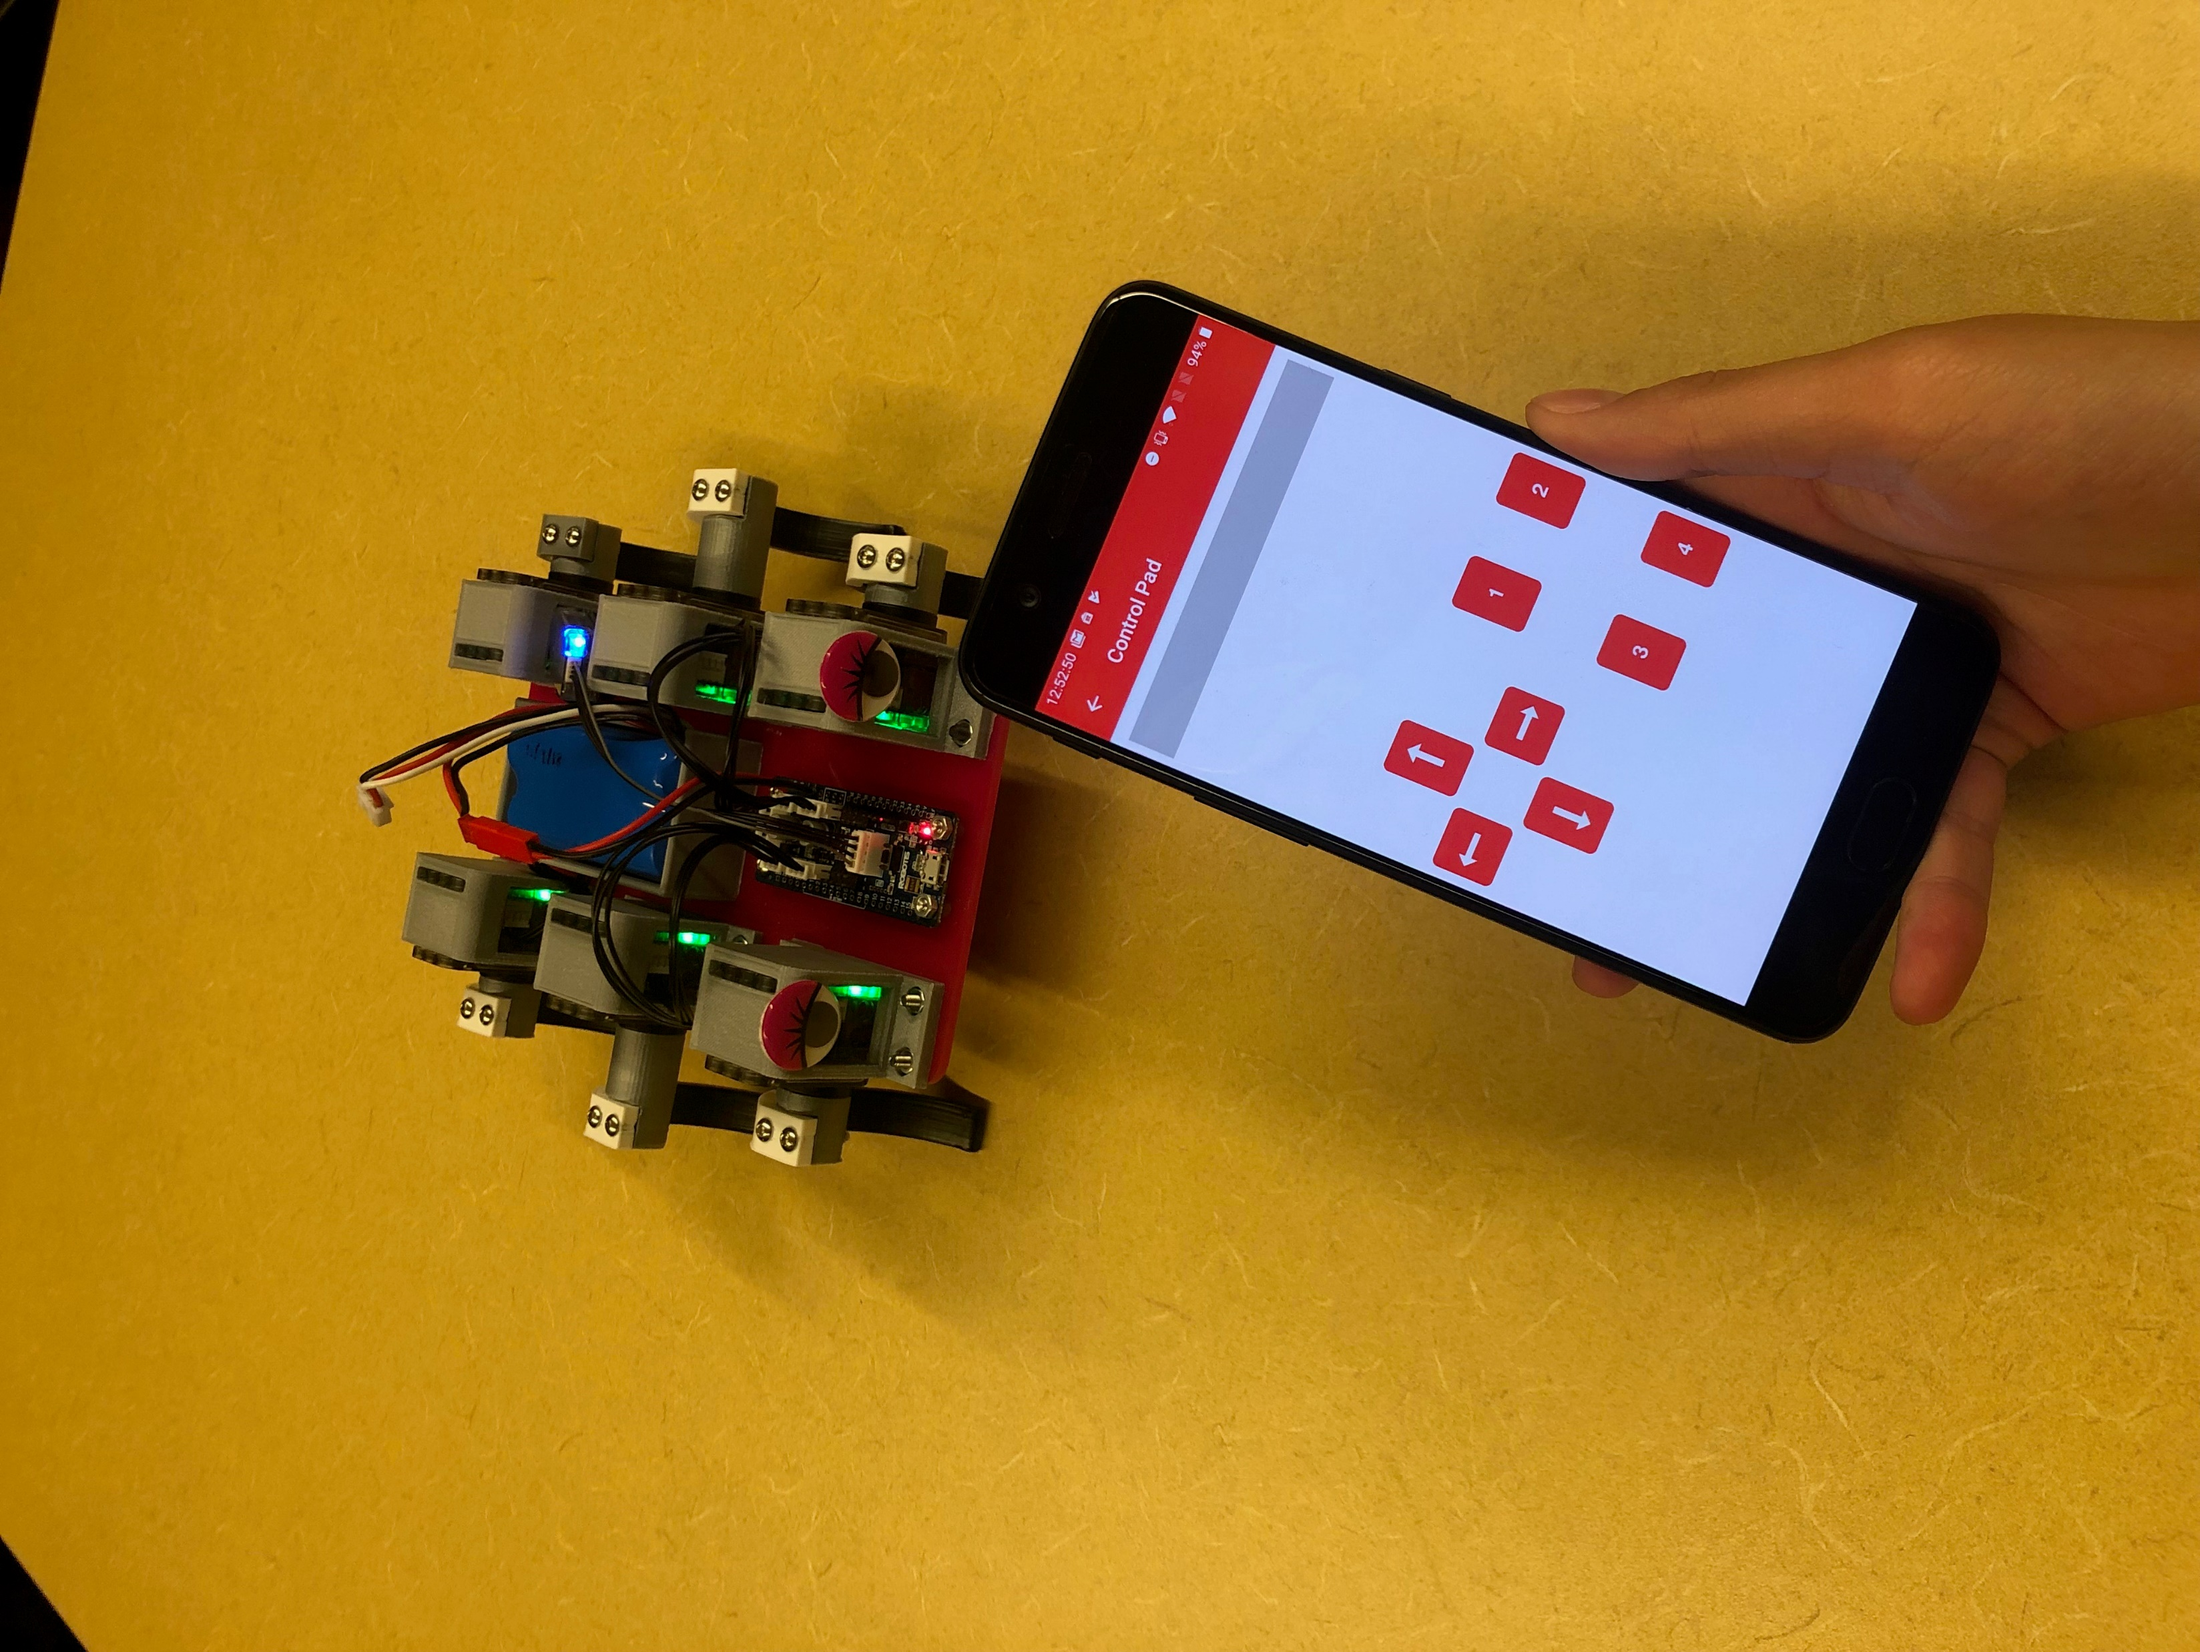
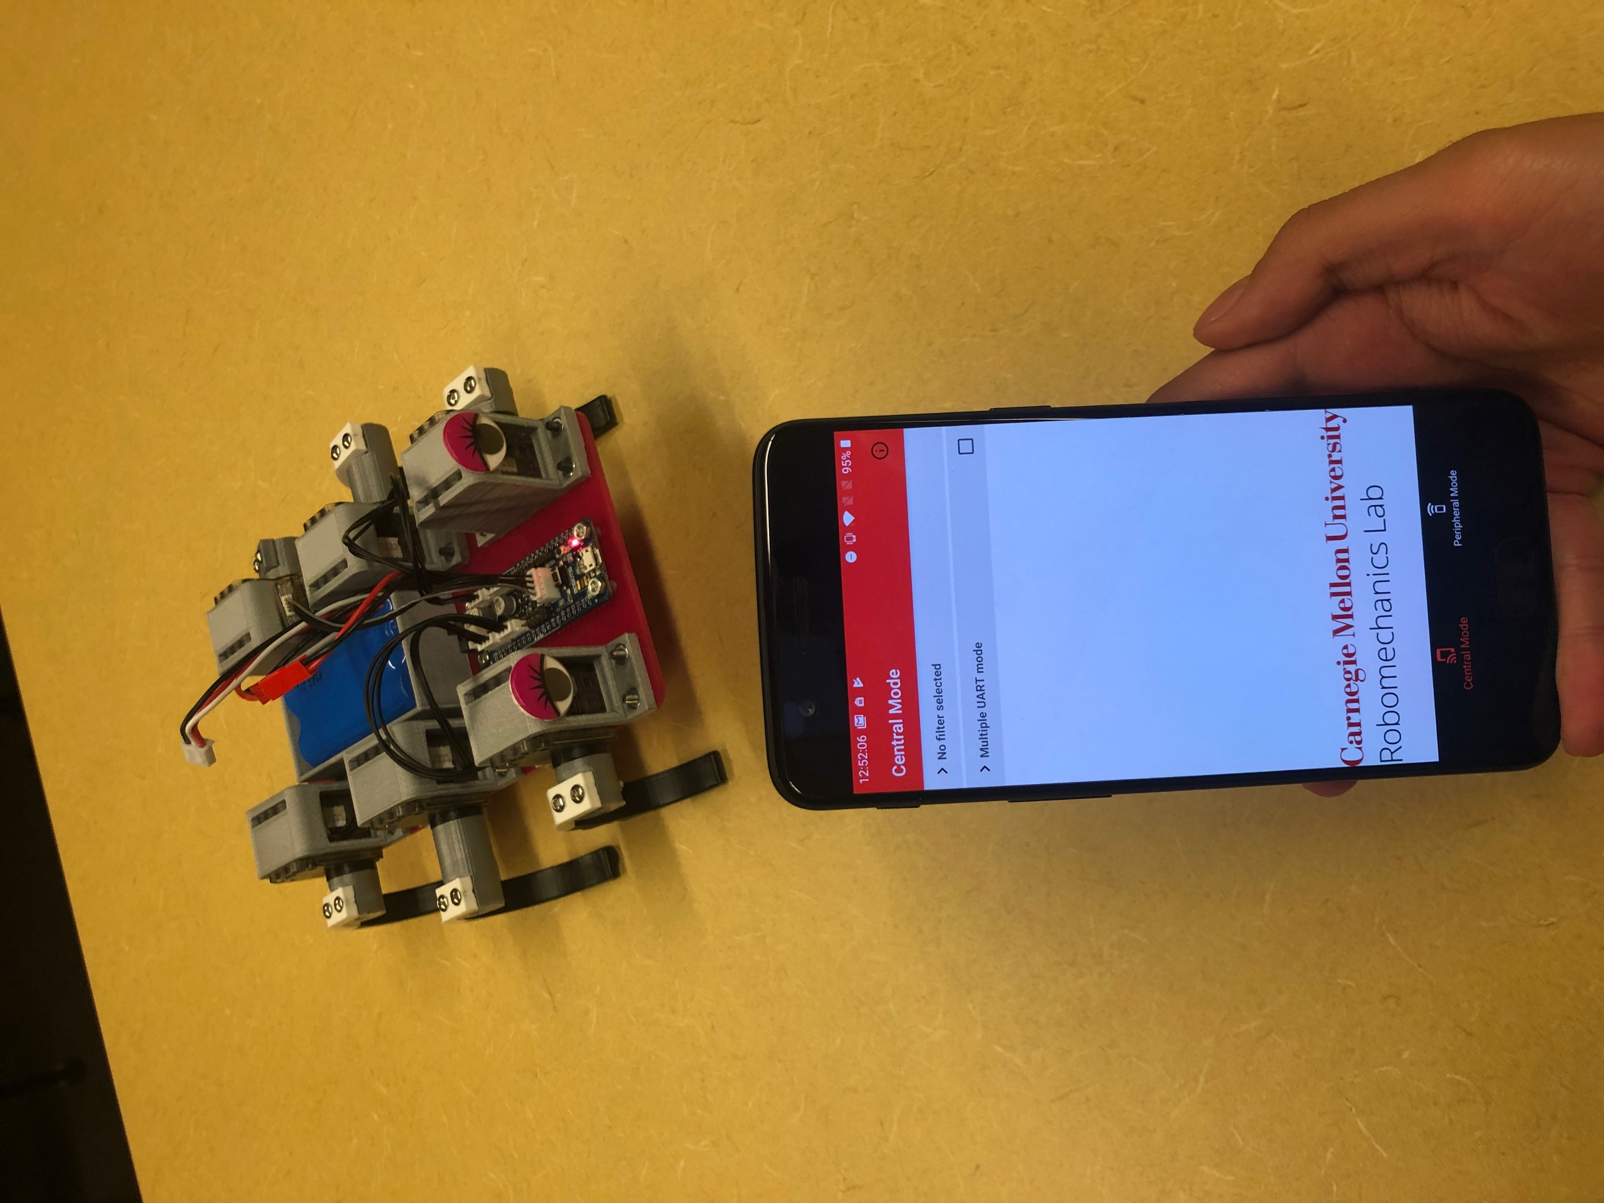
Bluetooth Low Energy Communication and Computer Vision for Small Scale Legged Robots
Hannah He and Aaron Johnson
Carnegie Mellon University, Department of Mechanical Engineering
https://github.com/hannahhe/MobiMini
Summary
Results
Future Work
MobiMini, a mobile Android application, was developed as a new medium for communication and a new form of autonomy to MiniRHex, a miniature scale hexapod based on the design of RHex. Building upon MiniRHEx’s customizability over its behavior and gaits, the app will allow for data collection, testing of gait-tuning, and a simpler platform for outreach.
Notable features include the use of Bluetooth low energy control and will soon showcase tag following using an onboard phone and camera.
Built upon the framework for Bluetooth Low Energy connection put forth by Adafruit Industries in Bluefruit, MobiMini is also under development in utilizing an AprilTag tracking library by John J. Wang.
The simple control pad, with directional arrows features a while-held feedback loop in order to control the stop and go motion of MiniRHex.
Other buttons can be linked to the various gaits that MiniRHex can achieve, including pronking, alternating tripod (running), jumping, or other user-specified gait patterns.
MobiMini also provides data on the connected Bluetooth LE module, including the services, characteristics, and descriptors provided by the module. Furthermore, there is a filter that allows the user to specify which specific Bluetooth LE devices that they would like to connect to, when initially discovering Bluetooth LE eligible devices.
The future design improvements in the user interface of MobiMini increase the flexibility and specificity of the features one may run a test on.
An analog joystick design/method of control over the drive train
Simple April-tag detection and automated following of the tag
A method to easily change between pre-programmed/user specified gaits
Motivation
The MobiMini was not only designed to bridge the communication gap between MiniRHex and the human, but to eventually give full autonomy to MiniRHex. It allows for movement control in the form of serial communication and a testing setup for studying the effects of camera stability on general computer vision algorithms.
Due to the small scale of MiniRHex, resource constraints such as decreasing the size of the camera or working with less computation power limit the quality of visual feedback. Similarly, computer vision on legged robots also results in shaky videos, which presents an interesting area of research for visual odometry.
MobiMini also creates a very visual platform for educational outreach to explore all of MiniRHex’s features. It simplifies and increases accessibility and customizability to help maximize the degrees of freedom in the interaction between the user and the robot.
In addition to the increased education opportunities MobiMini has opened, we are continuously developing other features with this platform:
Development of more stable advanced computer vision algorithms for small scaled robots
Introduce multiple parallel Bluetooth Low Energy connections over multiple MiniRHex robots for coordinated search and rescue missions
Easily gather data and testing for gait-tuning algorithms or mobile sensors
Incorporate data collection as a visual display on MobiMini with real-time graphing and plotting
Multi-platform support with Android and IOS

